Slide 1


Investigating the willingness-to-wait with real-time crowding information in urban public transport
Arkadiusz Drabicki – Cracow University of Technology
dr Rafał Kucharski – Cracow University of Technology
prof. Achille Fonzone – Edinburgh Napier University
Dawid Dudek – Cracow University of Technology
prof. Andrzej Szarata – Cracow University of Technology
9th International Symposium on Travel Demand Management
Edinburgh, 19th – 21th June 2019

Slide 2
Introduction
Overcrowding (passenger congestion) – notorious and recurrent issue in public transport networks
Despite ‘hard’ investment programmes – capacity expansion becomes eventually outstripped by the ever increasing demand pressure…
… instead – growing emphasis on ‘soft’ travel demand management strategies
ITS-fed data could be provided to passengers:
to help them make more informed choices
and thus improve journey experience
„I predict that when Crossrail opens in 2018 it will be immediately full. The people who predicted that it will take all the traffic out of Oxford Street or that we’ll be able to sit down on the Central Line in the rush hour will be wrong. It will just be full up with people.”
Sir Peter Hendy (2013)
Former Commissioner of Transport for London

Slide 3
Real-time crowding information - RTCI
public transport crowding
RTCI
- real-time
crowding information
ITS
ITS data, gathered in real-time, could be simultaneously handled to provide information (or even prediction) on passenger flows
increasingly feasible – APC, AFC, smart-card data, CFD…
RTCI – a fairly novel research topic:
impact on travel behaviour…?
proper system architecture / design…?
consequences for PT network effectiveness…?

Slide 4
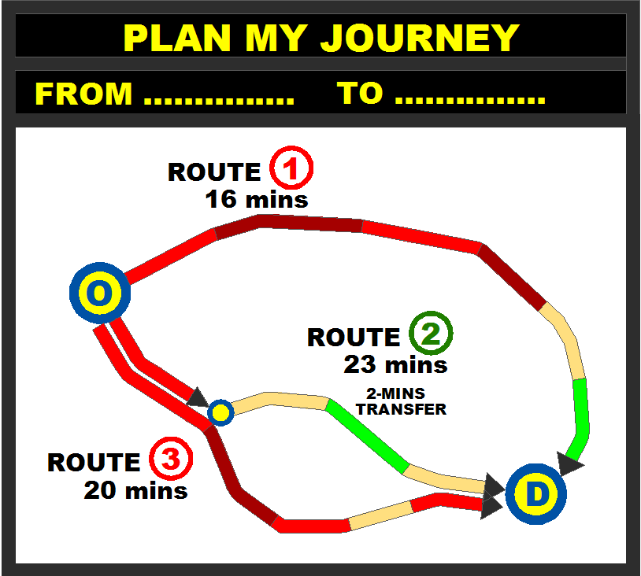
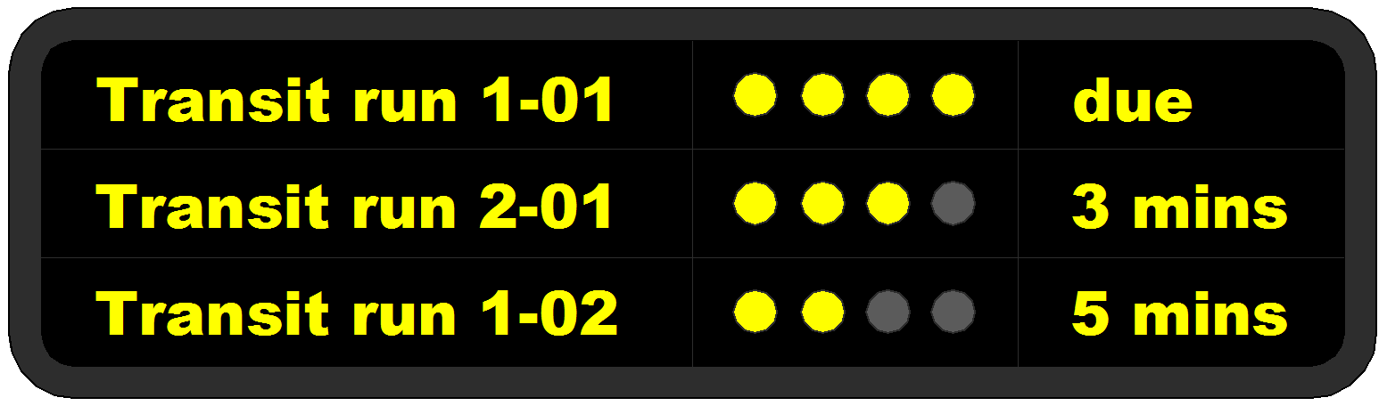
RTCI and travel behaviour
How could crowding information affect passengers’ travel choices?
spatial shifts
AND/OR
temporal shifts
willingness to reroute towards
a less-crowded PT line
➔ trade-off vs. in-vehicle time
willingness to wait for
a less-crowded departure
of this PT line
➔ trade-off vs. waiting time
- ?

Slide 5
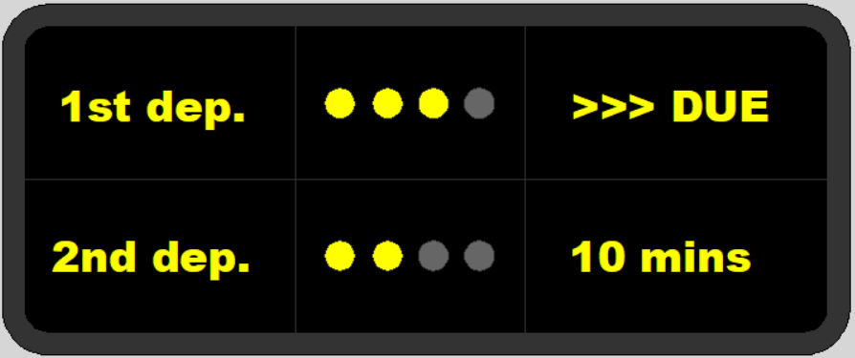
Methodology
Focus-group discussions
Passenger surveys at bus/tram stops in the city of Krakow (Poland)
~ 380 respondents, ca. 2,280 SP observations
Objectives:
attitudes/preferences towards the (future) crowding information systems
sample RTCI interpretation
SP choice survey
propensity to wait for a less-crowded vehicle
vs. trip- and population-related characteristics
➔ discrete choice model estimation
Q9. Which of these departures would you be willing to choose?
attributes:
crowding level (1st vs. 2nd trip)
waiting time for 2nd trip (5 – 10 minutes)
choice context
journey time / service frequency
time criticality / trip purpose
prior experience of PT crowding
sociodemographic data
age, gender

Slide 6
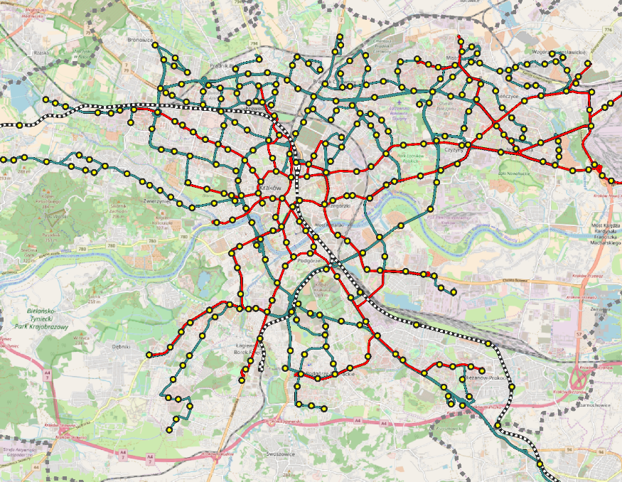
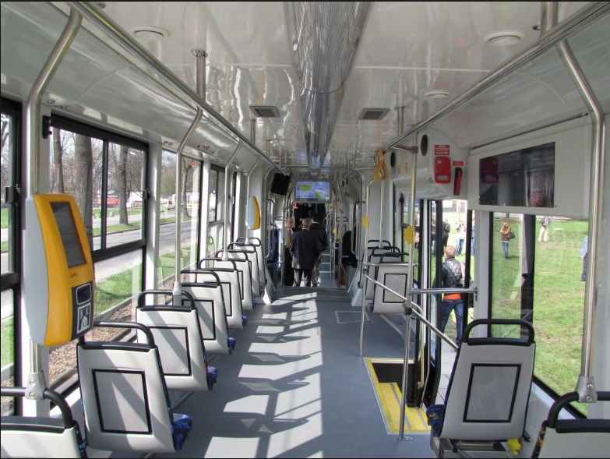
Case study – Krakow
Urban public transport (PT) system in Krakow (Poland):
population: 750k (metro area: ~ 1.4m)
core PT network: 155 [bus] and 23 [tram] lines, ca. 500k daily trips
PT vehicles: typically, increased standing space vs. reduced seating area

Slide 7


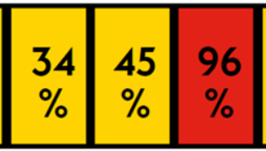
Focus groups: how to represent RTCI?
descriptive, rating scale
the most positive solution – clear and understandable message
simple yet sufficient enough to make a decision
gives a general idea how ‘bad / good’ the on-board comfort is
adequate for short, urban PT trips
numerical scale (seats available)
also popular, especially for long-distance trips and rail commuters
certain credibility concerns (e.g. sudden fluctuations in no. of seats)
percentage scale
in contrast – rather unfavourable reception so far
ambiguous in interpretation – what does it exactly mean?
[%] values might be perceived in terms of „gambling” risk
increased complexity for decision-making process
7

Slide 8
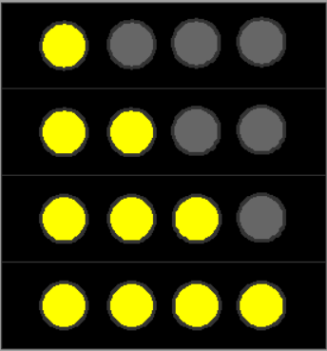
Focus groups: what kind of information from RTCI?
expectations | decision attitudes
over 50% of seats available expect a double seat just for myself | would choose this trip ‘at ease’
last few seats (< 10%) available might not get a seat | would board and wouldn’t ‘mind’ seeking a comfortable standing place
no seats available, but can stand comfortably overcrowding threshold | would take this trip, but expect some discomfort
severely overcrowded, no grip, hard to stand need to be lucky to ‘squeeze’ inside might not board | unless in a hurry – should consider different travel options
travel advice expected from the RTCI:
principally related to higher (over)crowding conditions:
for time-critical trips: denial-of-boarding risk
non-time-critical trips: ‘comfortable standing’ conditions and/or seats available
accuracy – key concern among respondents
would this information still be valid downstream?

Slide 9
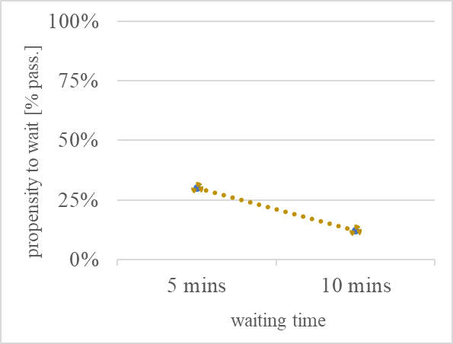
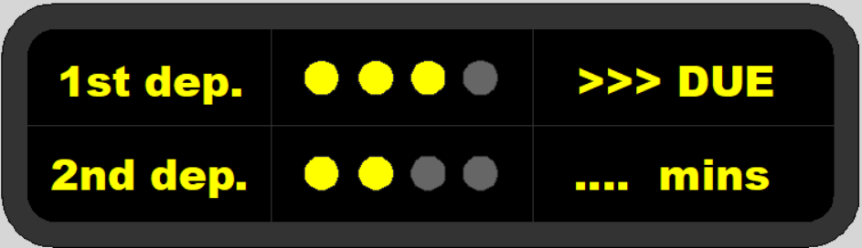
SP survey results
General results – stated willingness-to-wait
with crowding information on 1st and 2nd departure…:
1st dep: no seats, but can stand comfortably
2nd dep: seats available
case no. 1

Slide 10
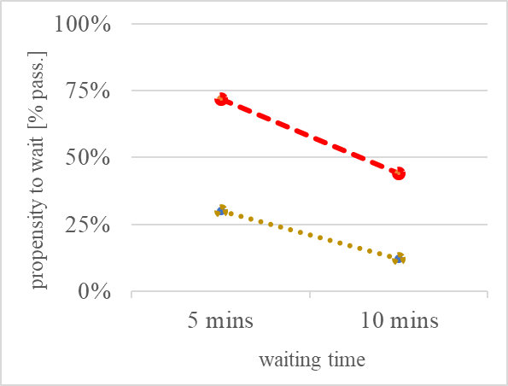
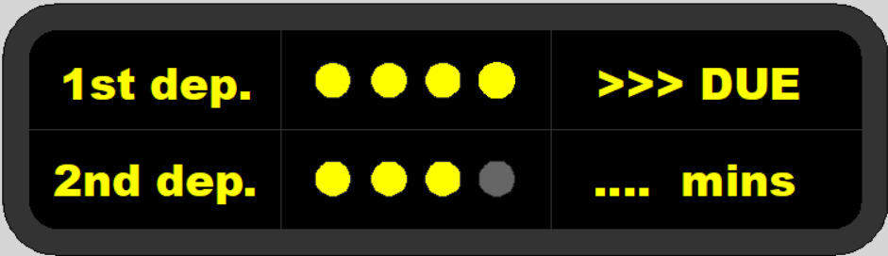
SP survey results
General results – stated willingness-to-wait
with crowding information on 1st and 2nd departure…:
1st dep: overcrowded, could barely board
2nd dep: can stand comfortably
case no. 2

Slide 11
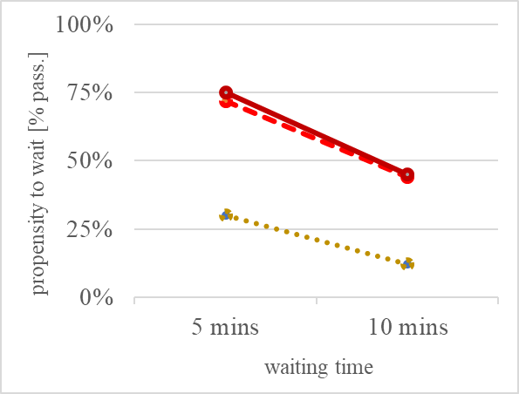
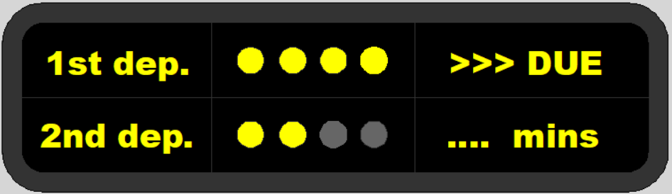
SP survey results
General results – stated willingness-to-wait
with crowding information on 1st and 2nd departure…:
1st dep: overcrowded, could barely board
2nd dep: seats available
case no. 3

Slide 12
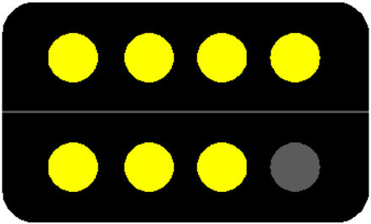
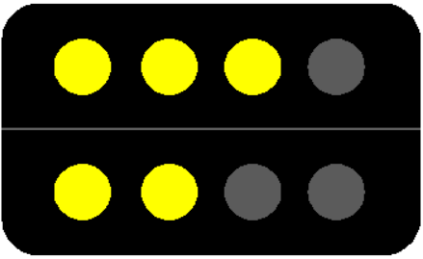
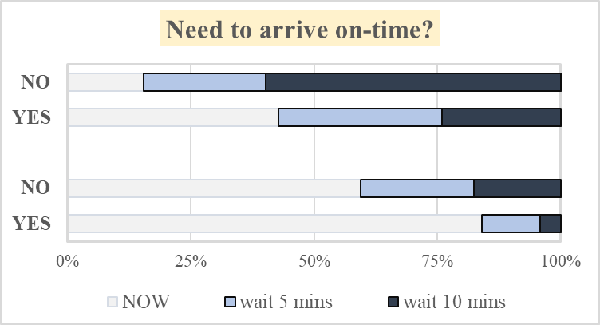
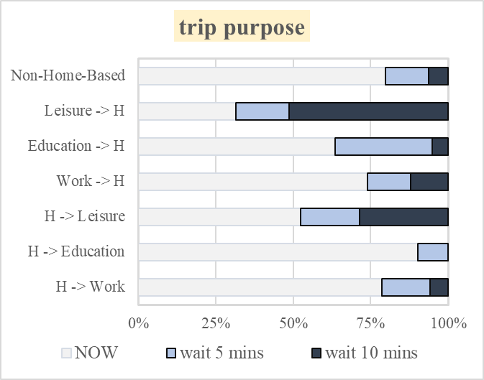
SP survey results
case no. 1
case no. 2
case no. 1
Relevance of trip purpose and time-criticality – higher (stated) willingness-to-wait for:
non-time-critical trips (‘I don’t need to arrive on-time’)
non-obligatory trips
home-return trips

Slide 13
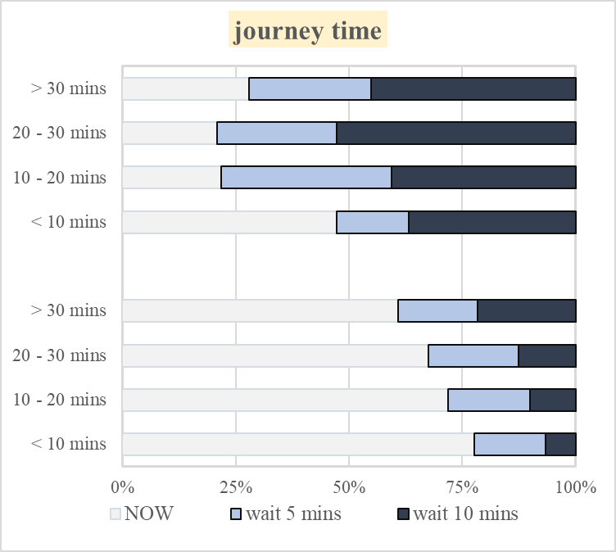
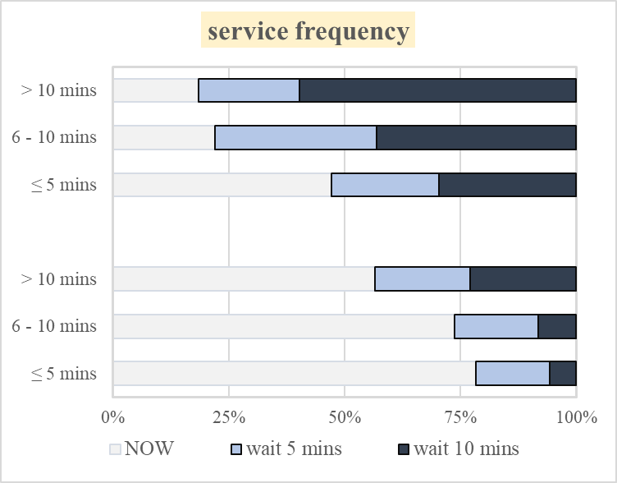
SP survey results
Trip duration – relatively minor impact:
* majority of sampled trips no longer than 30 minutes

Slide 14
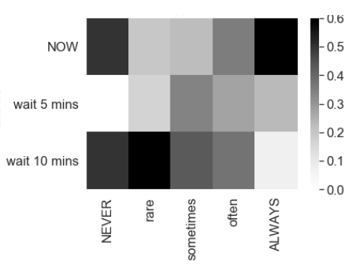
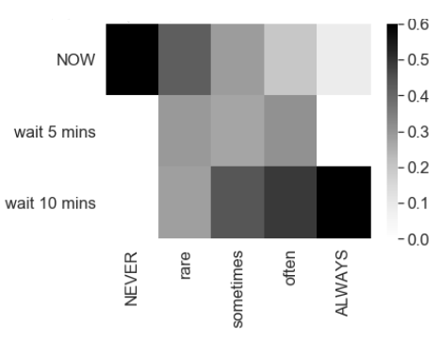
SP survey results
The more frequent the experience of PT overcrowding, the lower the passengers’ propensity to avoid it:
How often do you experience overcrowding in your urban PT trips?
How often are you able to get a seat during your urban PT trips?
[SP answers]
[% of respondents]
*
* limited sample

Slide 15
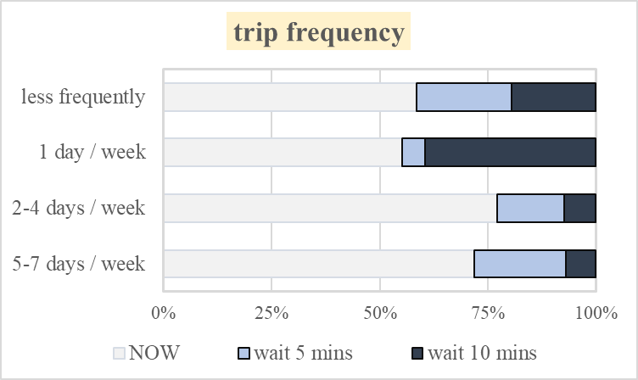
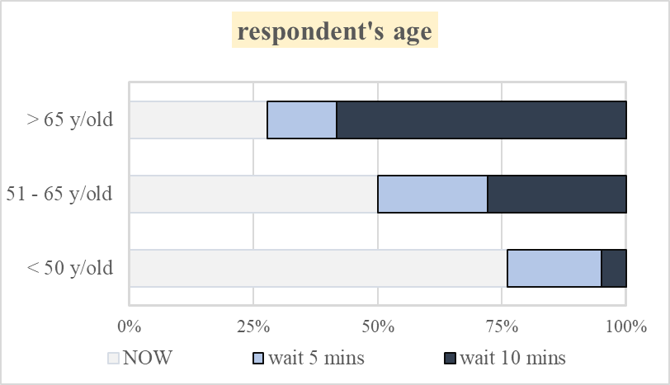
SP survey results
Sociodemographic characteristics:
limited propensity to wait to reduce crowding among PT commuters and those under the age of 50

Slide 16
Choice modelling
Discrete choice model estimation based on SP results:
BIOGEME package (Bierlaire, 2009)
MNL (multinomial logit) model
objective – choice probability between 2 alternatives:
depart [NOW]
utility U₀
[WAIT] and depart later
utility U₁
OR
Waiting utility U₁ calculated as a function of:
temporal utilities
in-vehicle time
waiting time
Boolean attributes
RTCI of 1st vs. 2nd departure
other trip- and population-related characteristics

Slide 17
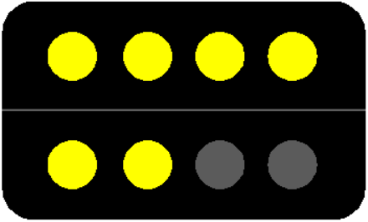
Choice modelling (a) – general model
depart [NOW]:
[WAIT]:
all trips |  | value | std err | t-test | p-value
β_{a}^{CR} case 1. |  | 0.439 | 0.234 | 1.87 | 0.0613
β_{b}^{CR} case 2. |  | 2.62 | 0.245 | 10.7 | 0
β_{c}^{CR} case 3. |  | 2.69 | 0.246 | 10.9 | 0
β ^{IVT} |  | 0.0237 | 0.00441 | 5.37 | 8.00E-08
β₁ ^{WT} |  | -0.29 | 0.0215 | -13.5 | 0
β ^{TCRIT} |  | -1.41 | 0.109 | -13 | 0
β ^{PTC} |  | -0.144 | 0.141 | -1.02 | 0.306
β ⁶⁵ |  | 1.92 | 0.23 | 8.35 | 0
β ⁵⁰⁻⁶⁵ |  | 0.72 | 0.242 | 2.97 | 0.00295
n = 2,280 |  |  | Rho-square: |  | 0.277
crowding level (RTCI) of 1st vs. 2nd departure (case-specific)
in-vehicle time
wait time
time-criticality
commuter (2+ trips / week)
age 65+
age 50 -65
boolean
time
boolean

Slide 18
Choice modelling (b) – time-criticality distinguished
depart [NOW]:
[WAIT]:
RTCI of 1st vs. 2nd departure
+
waiting time
time-critical trips |  | value | std err | t-test | p-value
β_{a}^{CR} case 1. |  | -0.218 | 0.267 | -0.819 | 0.413
β_{b}^{CR} case 2. |  | 1.7 | 0.252 | 6.78 | 1.23E-11
β_{c}^{CR} case 3. |  | 1.76 | 0.253 | 6.97 | 3.24E-12
β ^{WT} |  | -0.292 | 0.0314 | -9.31 | 0
n = 1,026 |  |  | Rho-square: |  | 0.264
non-time-critical trips |  | value | std err | t-test | p-value
β_{a}^{CR} case 1. |  | 0.926 | 0.217 | 4.26 | 2.07E-05
β_{b}^{CR} case 2. |  | 2.93 | 0.251 | 11.7 | 0
β_{c}^{CR} case 3. |  | 3.02 | 0.253 | 11.9 | 0
β ^{WT} |  | -0.253 | 0.0273 | -9.25 | 0
n = 1,254 |  |  | Rho-square: |  | 0.201
boolean
time

Slide 19
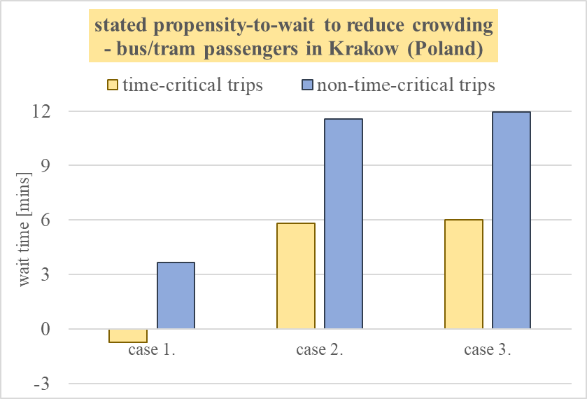
Estimation results - willingness-to-wait
MNL estimation results:
value of time multipliers journey time = 20 [mins] | time -critical | non-time-critical
case 1. | 0.96 | 1.18
case 2. | 1.29 | 1.58
case 3. | 1.30 | 1.60
SP findings among UK rail passengers
- (Preston et al., 2017):
acceptable wait ca. 15 – 22 [mins]
VoT multipliers ~ 1.25 – 1.75 (JRT = 30 [mins])

Slide 20
Conclusions
preference towards crowding information (RTCI) in urban PT:
simplified, descriptive representation
SP results – RTCI could induce willingness-to-wait:
principal choice ‘trigger’ – avoid excessive (over)crowding in the 1st vehicle
relevance of: trip purpose, propensity to arrive on-time, user characteristics…
on average, acceptable wait of 6 – 12 [mins] for a less-crowded vehicle
applicability and future considerations:
RTCI implementation as demand management tool (e.g. mitigating the bunching effects)
simulation models – passengers’ choices and network performance
stated vs. revealed choices with RTCI?
RTCI credibility – key to its effectiveness

Slide 21



Thank you very much for your attention!
adrabicki@pk.edu.pl
A.Fonzone@napier.ac.uk
rkucharski@pk.edu.pl
dawid.doodek@gmail.com
aszarata@pk.edu.pl
This work was supported by the STSM Grant from COST Action TU1305: Social Networks and Travel Behaviour.

